Slide 1
MAJOR PROJECT-1
DEPLOY OF THREE TIER APPLICATION USING TERRAFORM

Slide 2
STEP-1
CREATE AN INSTANCE AND INSTALL TERRAFORM

Slide 3
STEP-2
VPC CREATION:

Slide 4
STEP-3
SUBNET CREATION

Slide 5
STEP-4
INTERNET GATEWAY CREATION

Slide 6
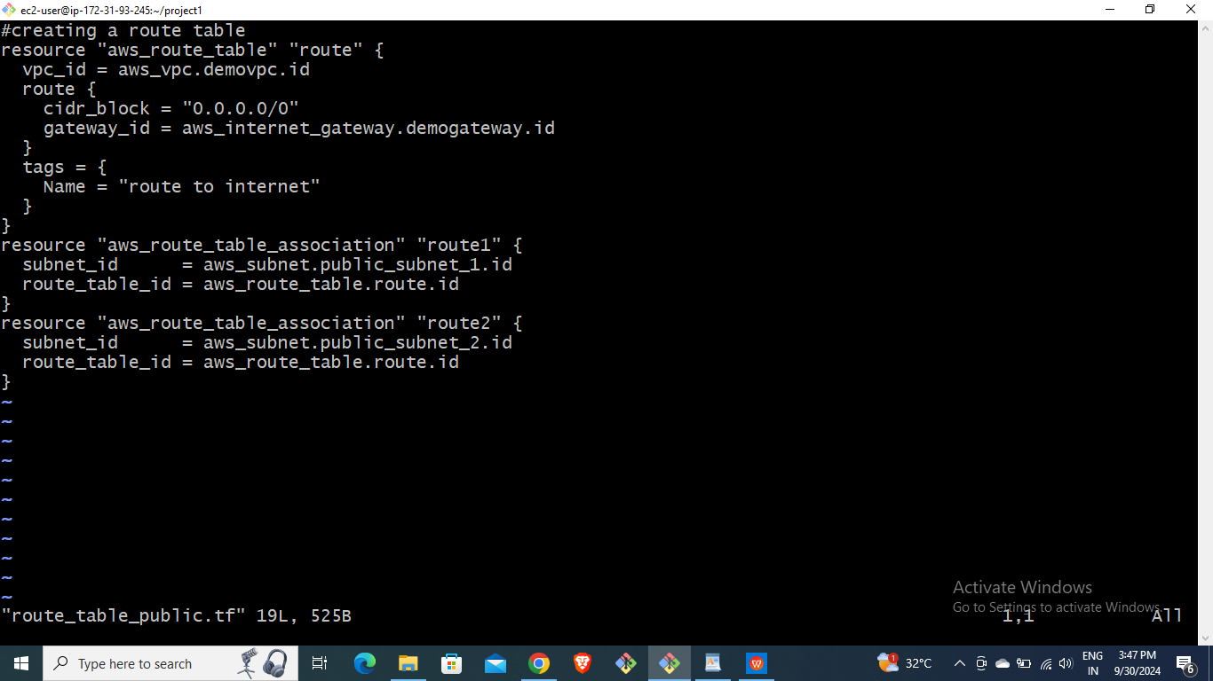
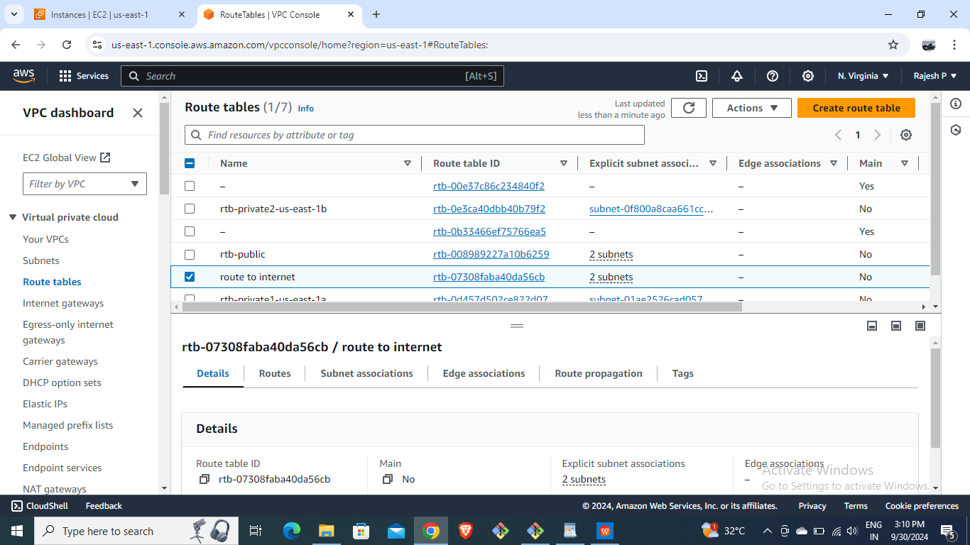
STEP-5
ROUTE TABLE CREATION

Slide 7
STEP-6
CREATION OF TWO EC2 INSTANCES

Slide 8
STEP-7
CREATION OF SECURITY GROUPS

Slide 9
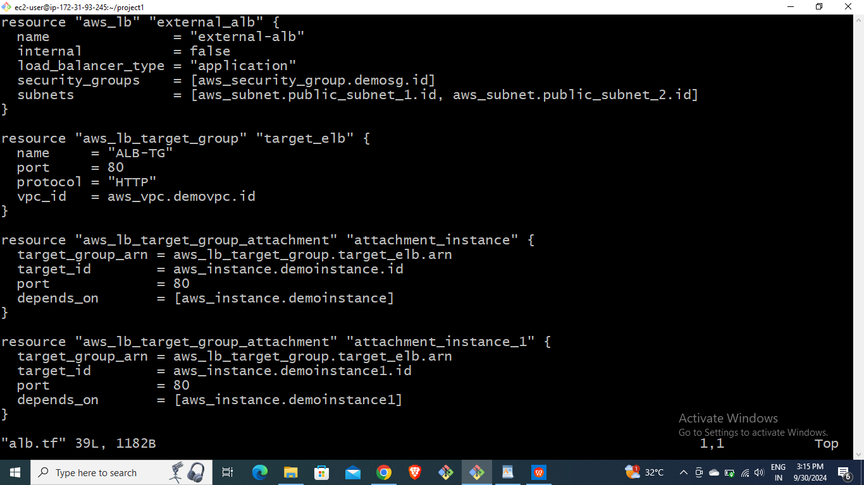
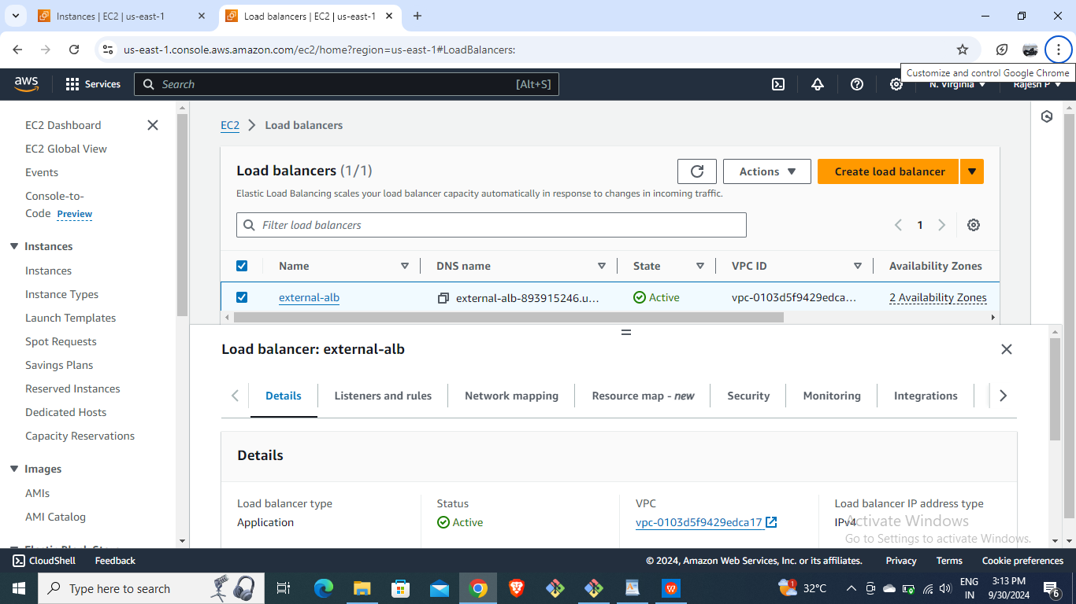
STEP-8
CREATION OF LOAD BALANCER

Slide 10
STEP-9
CREATION IF AUTO SCALING GROUPS

Slide 11
STEP-10
CREATION OF RDS.

Slide 12
STEP-11
BROWSE THE URL OF LB AND IT SHOWS LOAD IS BALANCING B/W TWO INSTANCES.

Slide 13
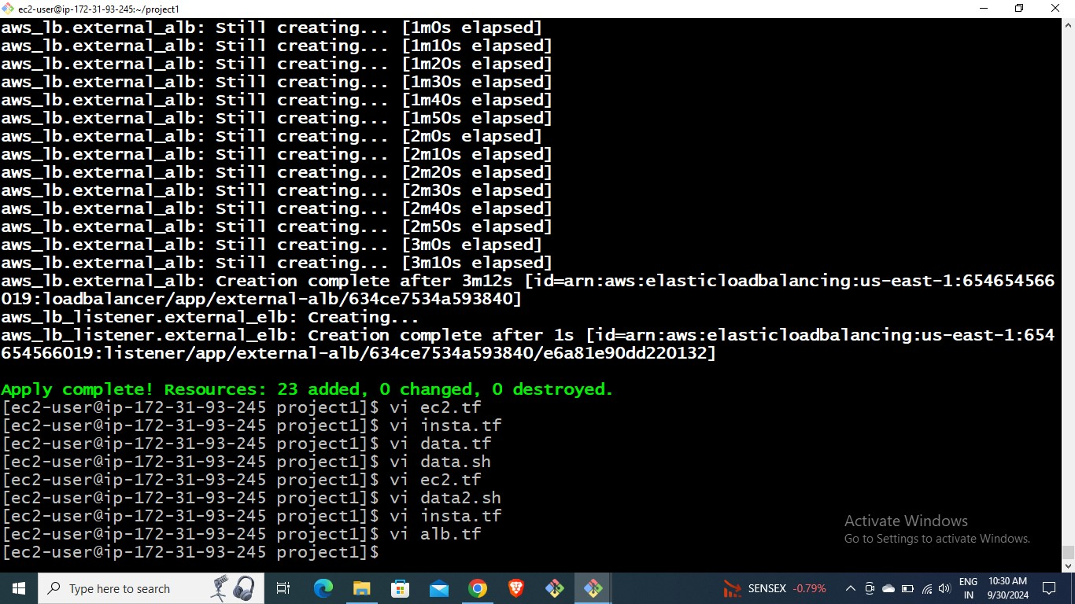
STEP-12
USING ‘TERRAFORM DESTROY’ COMMAND

Slide 14
THANK YOU

